Slide 1
Course Name: Database Systems Course Code: CS52 Credits: 3:1:0 UNIT 4 Term: Oct 2021 – Feb 2022
M.S. Ramaiah Institute of Technology
(Autonomous Institute, Affiliated to VTU)
Department of Computer Science and Engineering
Faculty:
Dr. Sini Anna Alex

Slide 2
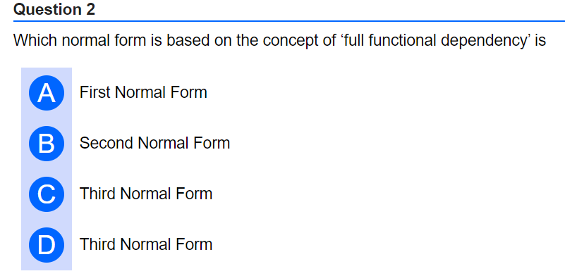
Ans:B

Slide 3
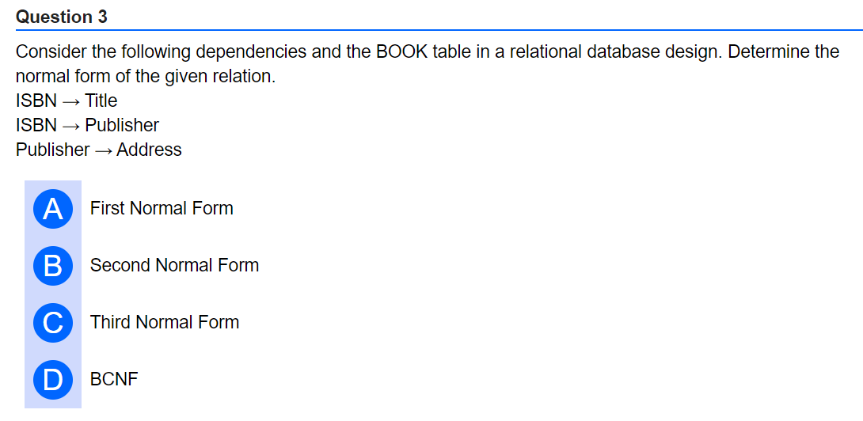
Ans:B

Slide 4
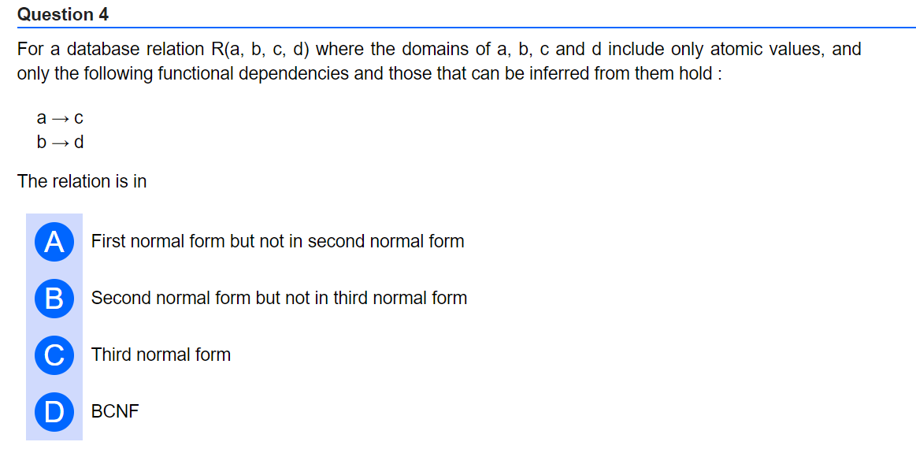
Ans:A

Slide 5
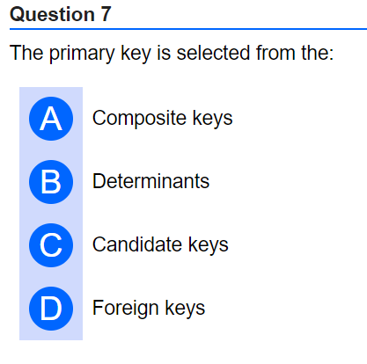
Ans:C

Slide 6
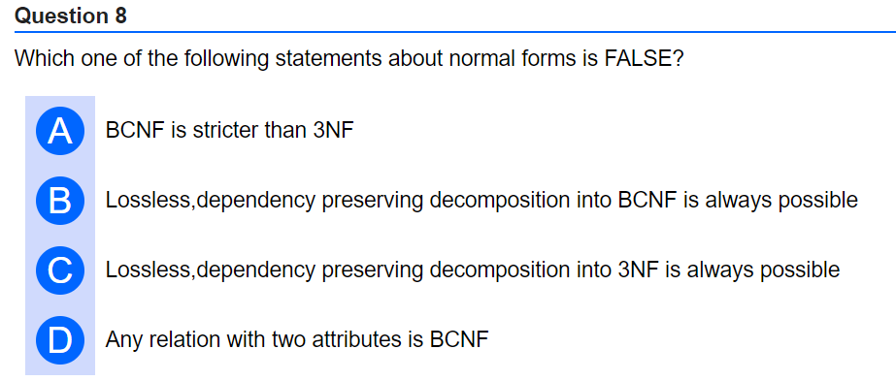
Answer: B
It is not always possible to decompose a table in BCNF and preserve dependencies. For example, a set of functional dependencies {AB –> C, C –> B} cannot be decomposed in BCNF.

Slide 7
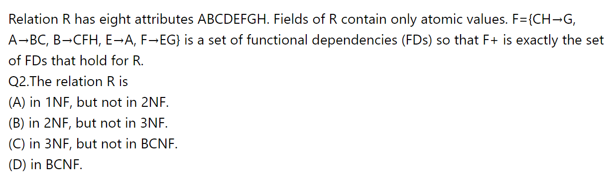
Ans:A

Slide 8
Consider schema R=ABCD, D = {R1= AB, R2= BC, R3= CD } subjected to F = { A→B, B→C, C→D, D→A }.
Test for non additive join property

Slide 9
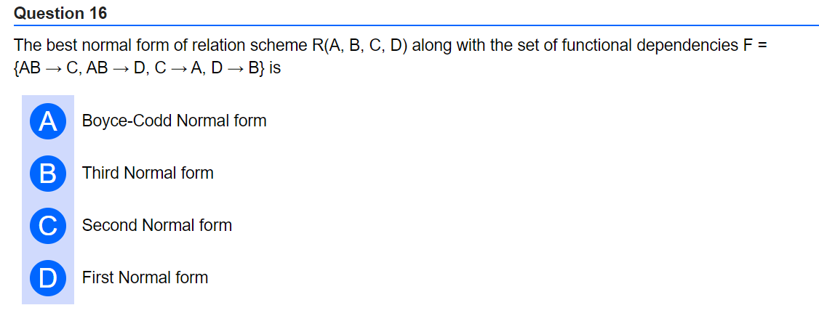

Slide 10
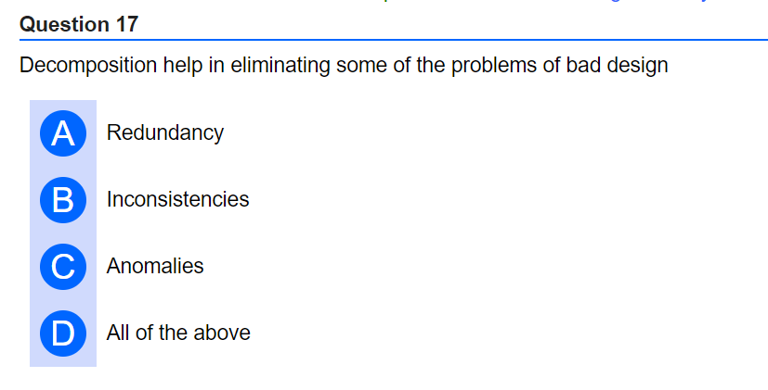
Ans:D

Slide 11
Thank you

